Slide 1
EIGHTH EPISCOPAL DISTRICT PRESIDENT’S REPORT
PATRICIA W. CAMPBELL

Slide 2
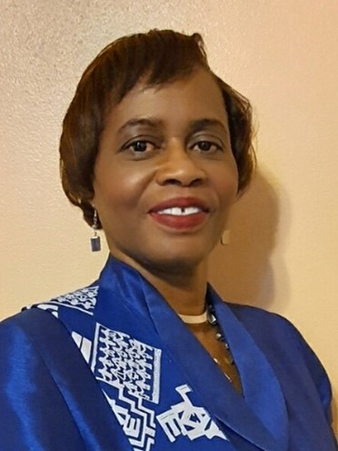
GREETINGS
Greetings from the Electrifying, Energizing, and Exciting Eighth Episcopal District Lay Organization, where we are “Striving Together for Continued Progress”. We offer teaching, training, and empowerment to our members for Lay ministry, global leadership, and service following the tenets of Jesus Christ.
The Eighth Episcopal District Lay Organization is in the position of continual restoration, due to natural disasters and crises. These events being compounded with COVID, inflation and other issues have impacted the fulfilment of our vision and needs of the local churches and communities we serve. However, we are not deterred. We continue to praise God and give Him all the glory.

Slide 3
MEMBERSHIP
Number of active Lay Organisation members is approximately 350.
Number of Young Adults is approximately 35.

Slide 4
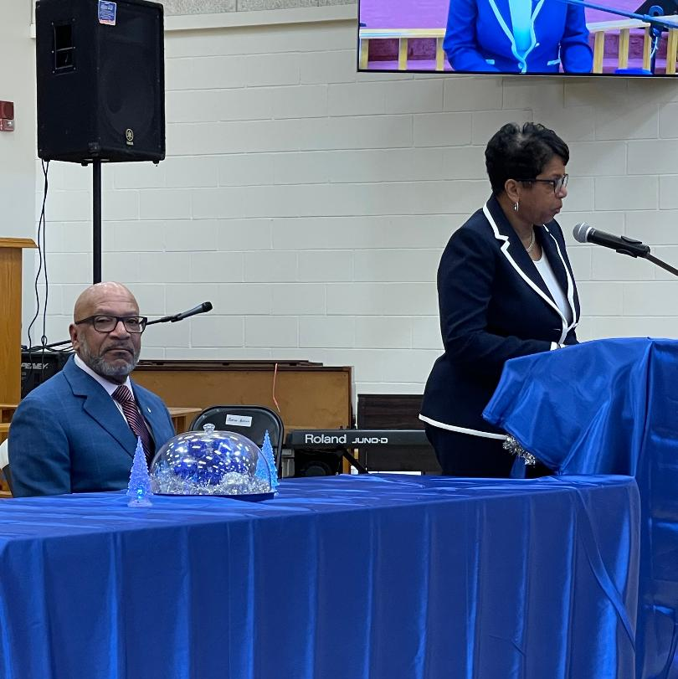
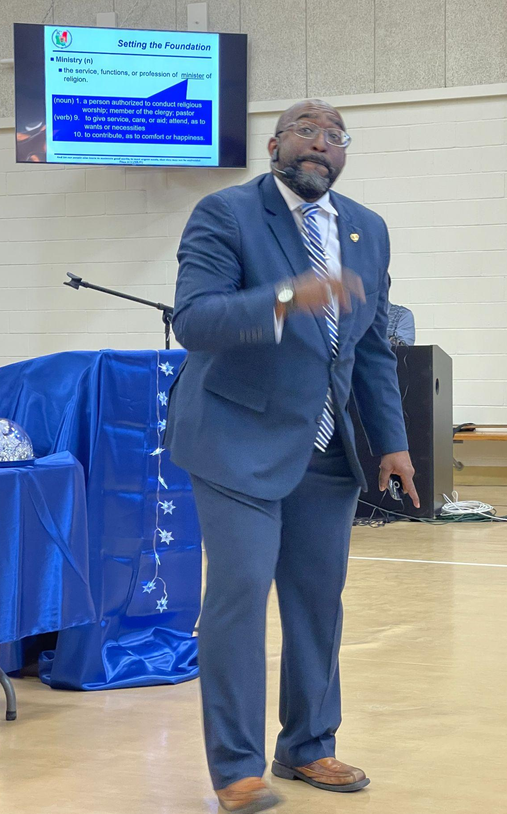
TRAINING
As an Episcopal District, we hosted the Reverend Dr. James Miller, General Officer, Department of Retirement Services at our Lay Convention. He presented a workshop on Restoring Credibility in the Church.
We also held an Effective Ministry Today workshop, presented by the Reverend Robert “Bob” Payne, of St. Mary AME Church, Shreveport.

Slide 5
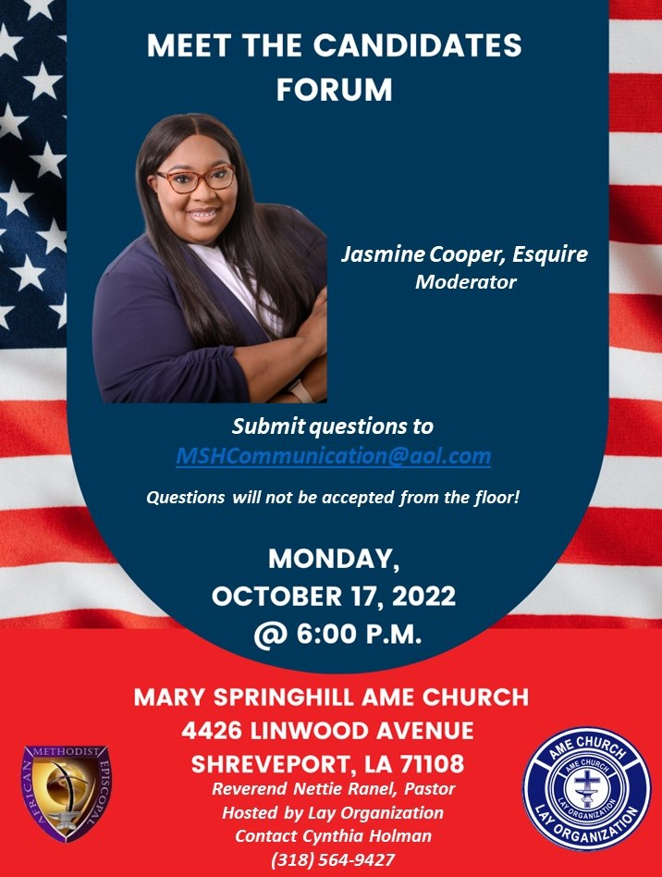
TRAINING
Throughout our Episcopal District we embraced our Bishop’s Vision of the 8C’s: Christ, Church, Character, Community, Credibility, Collateral, Credit, Capital. Our Conferences and Districts have incorporated the 8Cs in various Lay workshops and events.

Slide 6
TRAINING

Slide 7
ACCOMPLISHMENTS
Increased involvement of Local Churches in their communities Post Pandemic
Growth in Scholarship Awards
Growth in utilization of modern technology through the use of Zoom, Cash App and Social Media
Young Adults growth in Leadership Roles as Lay Presidents and Lay Speakers

Slide 8
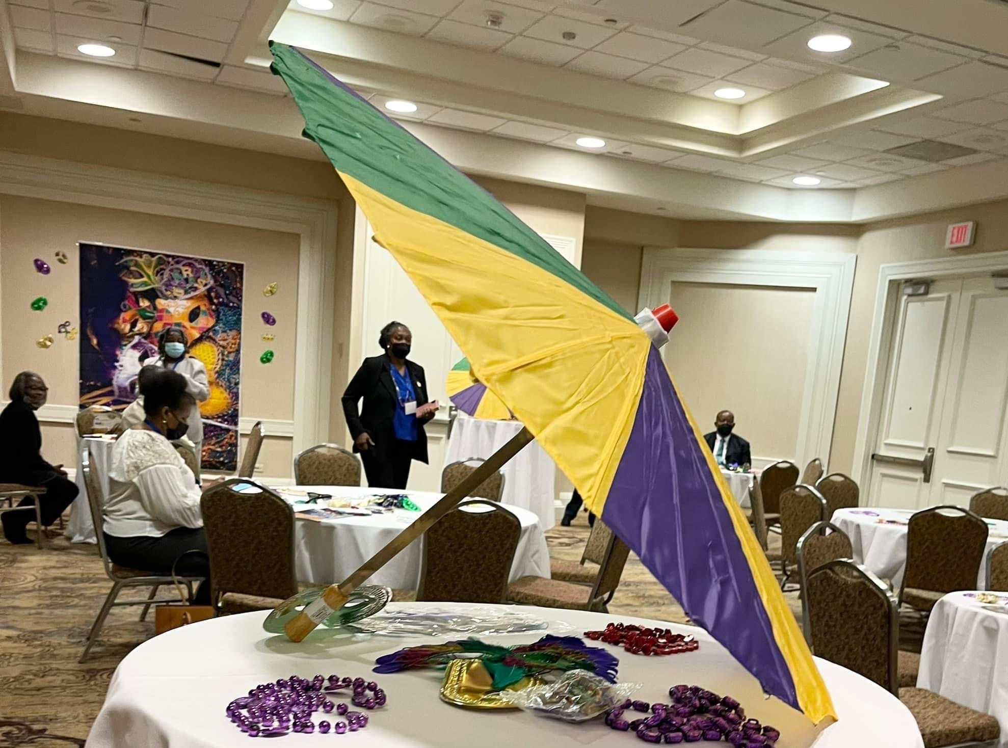
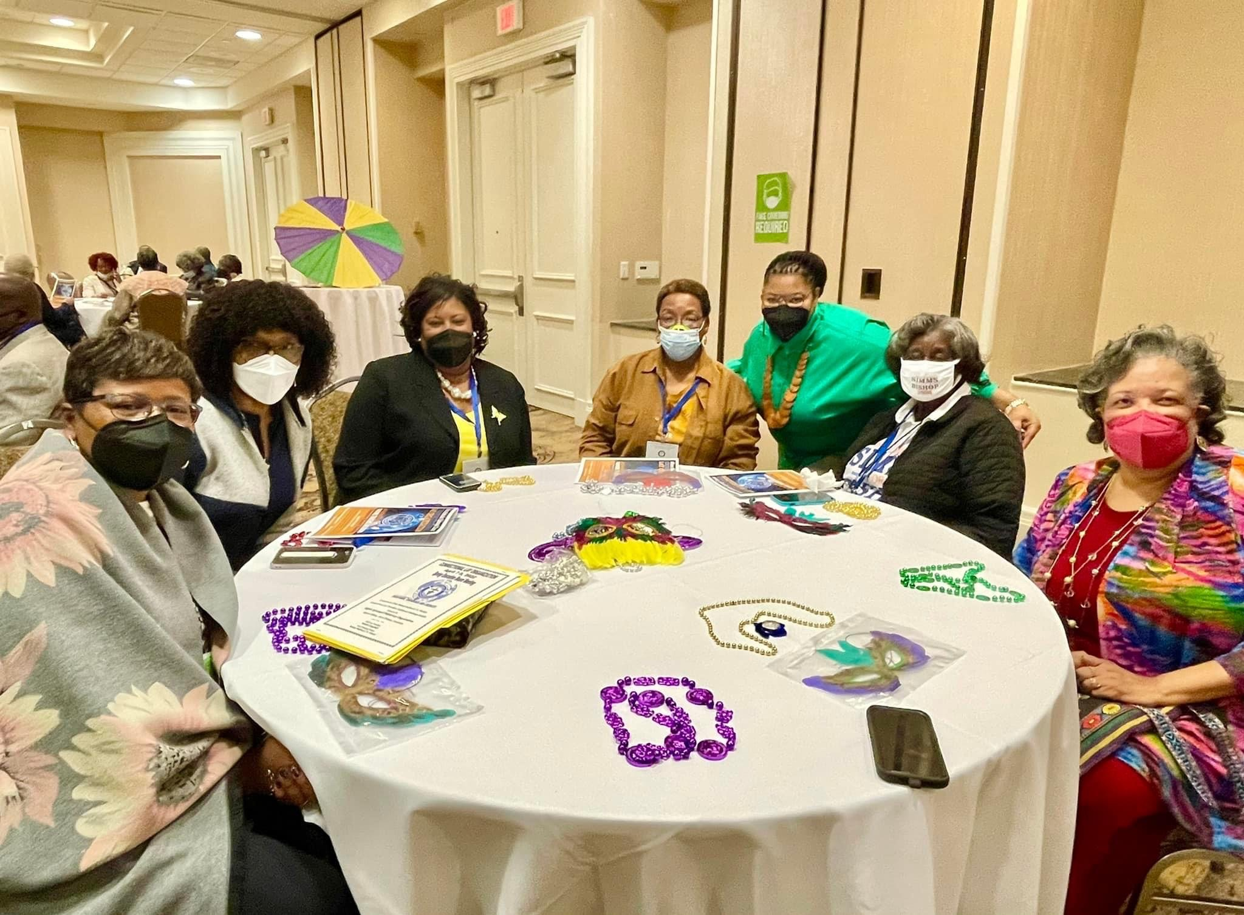
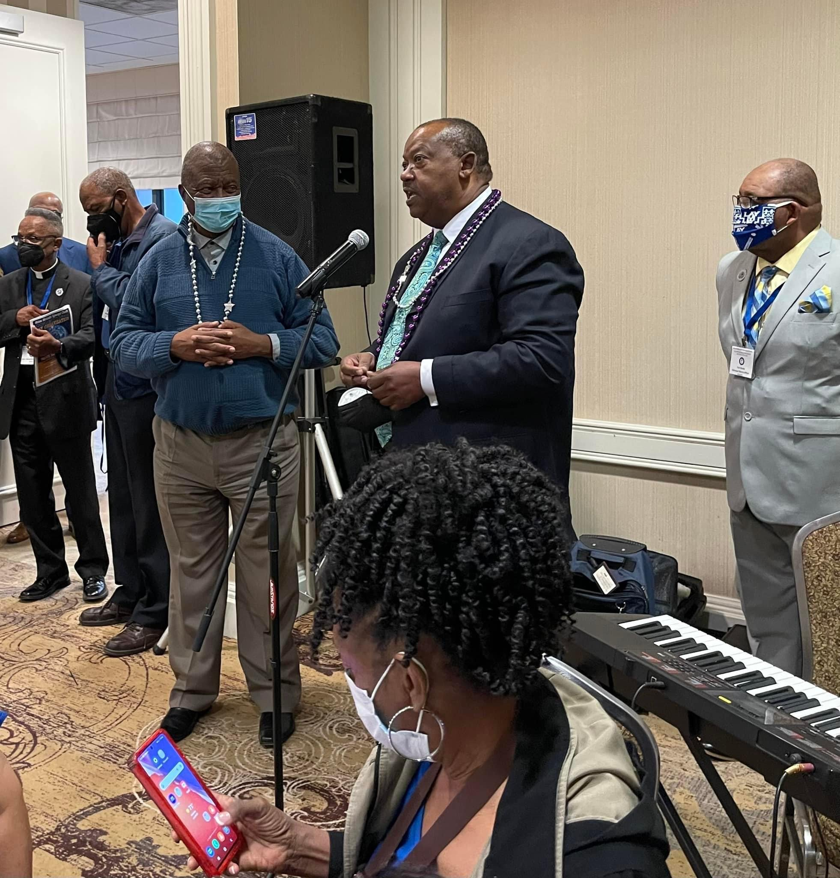
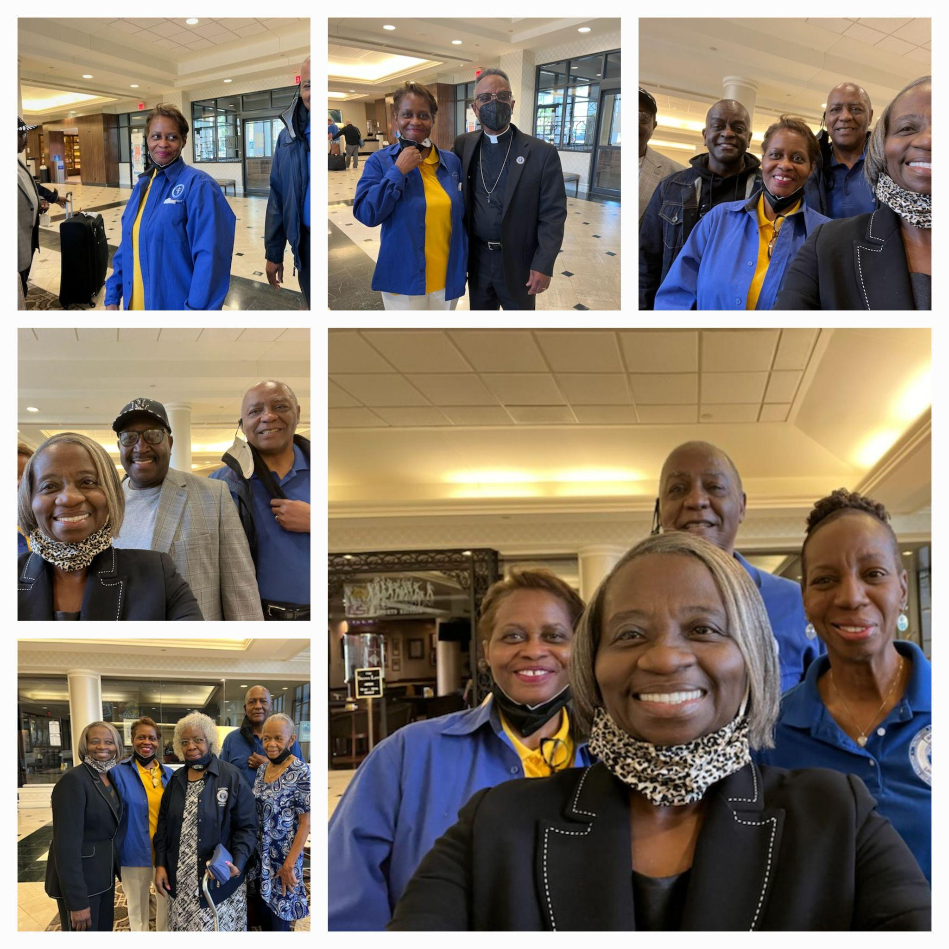
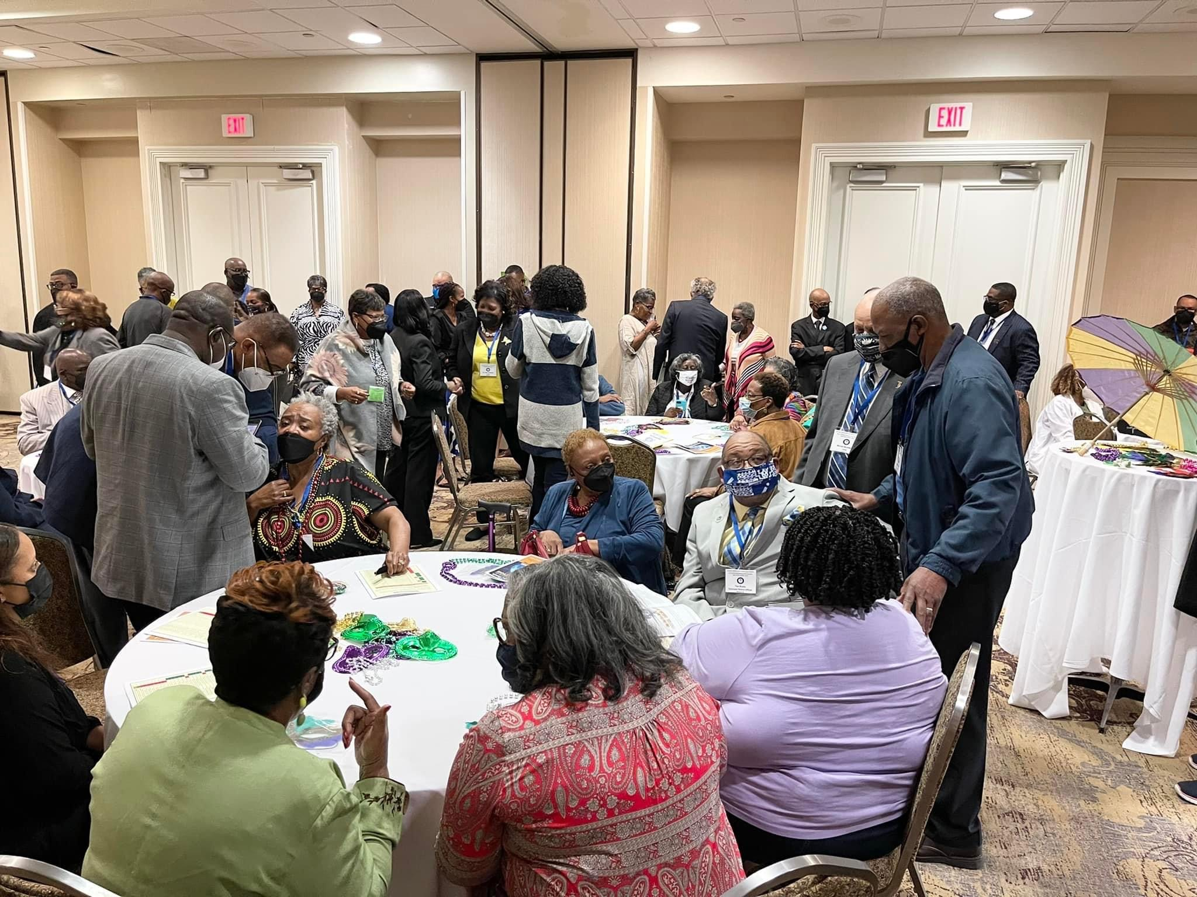
ACCOMPLISHMENTS
Hosted the Connectional Lay Organization Spring Executive Board Meeting. This was the first in-person meeting Post Pandemic.

Slide 9
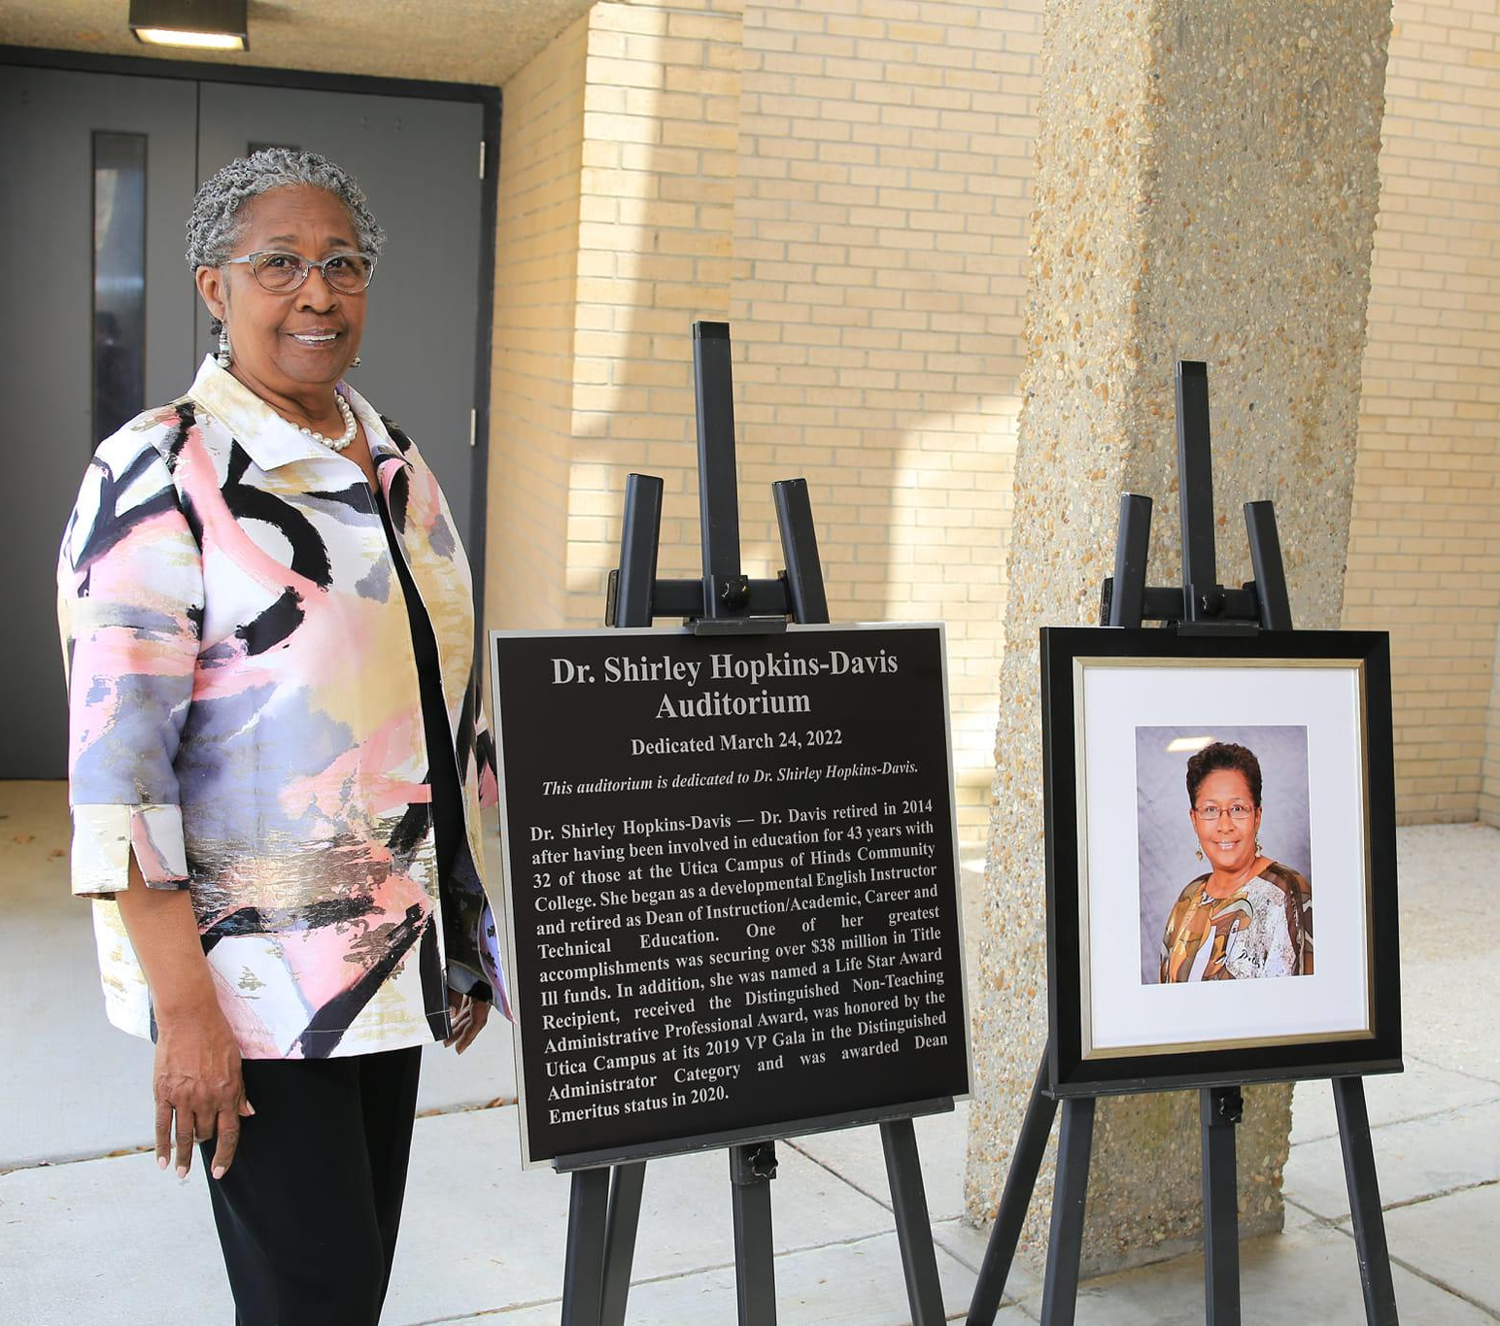
ACCOMPLISHMENTS
One of our Local Lay Leaders Dr. Shirley Hopkins-Davis was honored to have an auditorium at Hinds Community College named in her honor

Slide 10
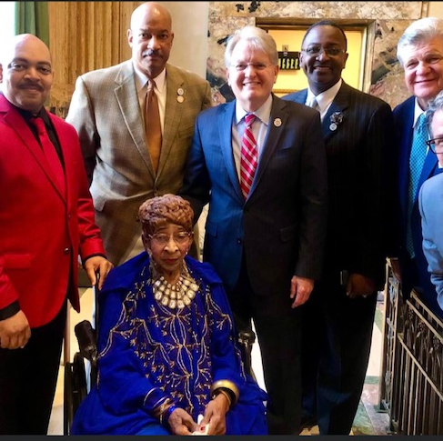
ACCOMPLISHMENTS
Another Local Lay Leader, Mrs. Ruby W. Smith, was honoured to have a building named in her honor after 56 years of service. The Ruby W. Smith Office of Child Welfare and Attendance

Slide 11
CHALLENGES
Recruiting, motivating, and retaining Young Adults
Overcoming COVID-19 Fatigue
Advocating for our Local Churches to return to their respective places of worship
Motivating the overall Lay Membership

Slide 12
CHALLENGES – HOW CAN WE HELP
Continue to offer informative training and workshops!
AND

Slide 13
UPCOMING EVENTS
Hosting an Episcopal Officers Retreat
Providing Leadership and Training Workshops
Preparing for the Connectional Lay Biennial Convention

Slide 14
EPISCOPAL LEADERSHIP
Sis. Patricia W. Campbell, President
Bro. Milton J., Chambliss, First Vice President
Sis. Theresa Travis, Second Vice President
Sis Earline Blackmore, Recording Secretary
Sis Irma Ross, Assistant Recording Secretary
Sis Frances Jones, Treasurer
Sis. Regenia Leonard, Financial Secretary
Dr. Shirley Hopkins Davis, Historiographer
Sis. Audreye Hall, Parliamentarian
Sis. Cynthia Holman, Acting Director of Lay Activities
Bro. Samuel Sarpong, Young Adult Representative
Sis. Florine Herron, Director of Public Relations
CONFERENCE PRESIDENTS
Sis, Linda Pate, MS Conference President
Sis. JoEtta McClain, North MS Conference President
Bro. Ton Brady, Central North LA Conference President
Sis. Maria Gauthier, Louisiana Conference President
ADVISORS
Bro. Melvin B. Davis, Immediate Past President
Sis. Glenda Minor
Bro. Robert Chambliss
Sis. Cynthia Holman
Sis. Stephanie Burks
Sis. Ylani Hayes, Esq., Special Advisor to the President

