Slide 1
20th EPISCOPAL DISTRICT
Presiding Prelate: Bishop Frederick A Wright
President: Bro Qedindaba Khumalo

Slide 2
MEMBERSHIP & TRAINING
Number of active Lay Organisation members in the district.
Number of Young adults who are members of the Lay Organisation in your district.
The above metrics could not be determined with any measure of accuracy for this report. Inter-country travel restrictions as well as poor digital communication being the principal reasons why this information could not be updated timeously.
The said work is ongoing and it is our hope and desire that the statistics, once compiled across the 5 constituent countries, will be communicated to the CLO and updated accordingly.

Slide 3
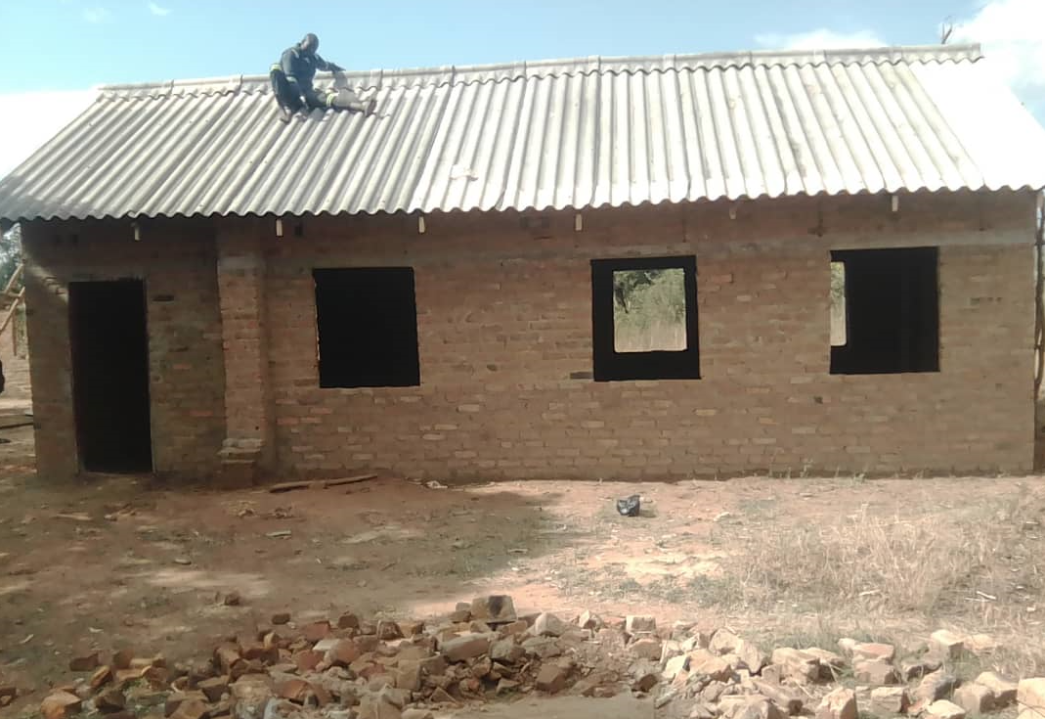
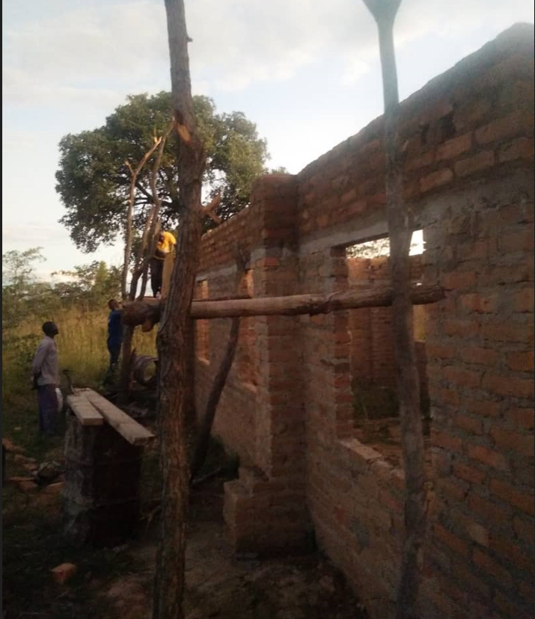
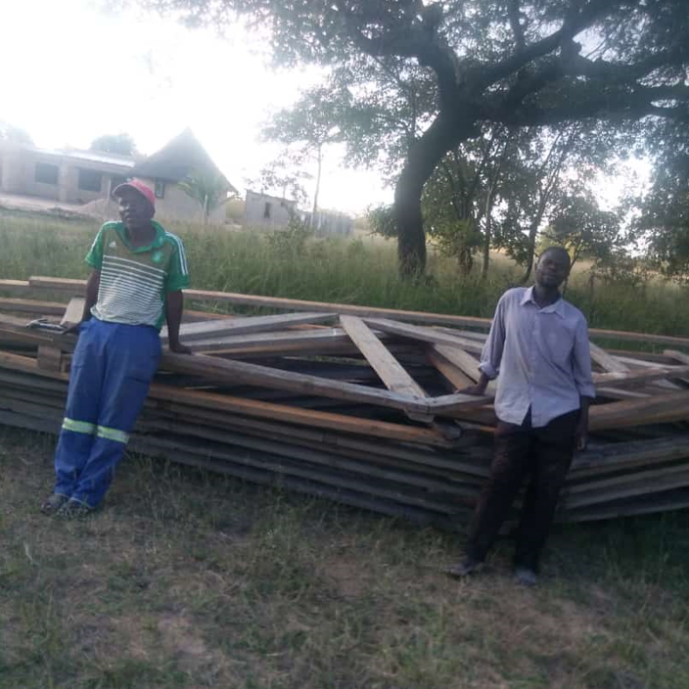
ACCOMPLISHMENTS
The construction of Mhondoro AME Church

Slide 4
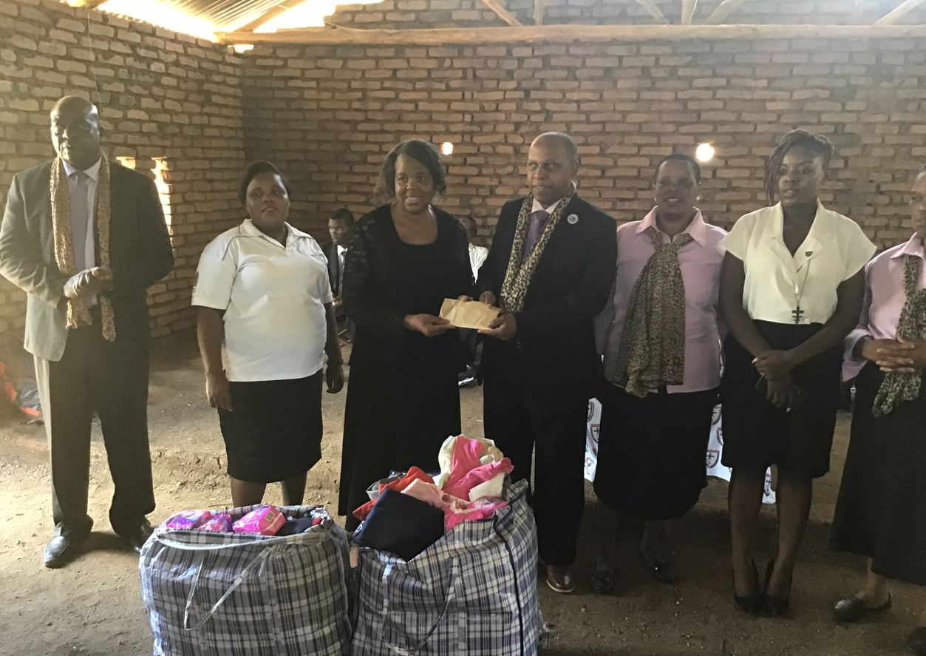
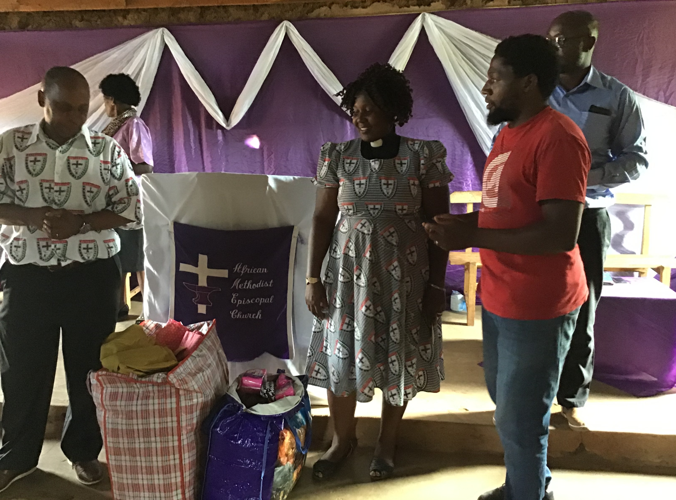
ACCOMPLISHMENTS
Presentation of donated material to Presiding Elders
Swinton for Mulanje District and Presiding Elder Madzoka from Central Malawi

Slide 5
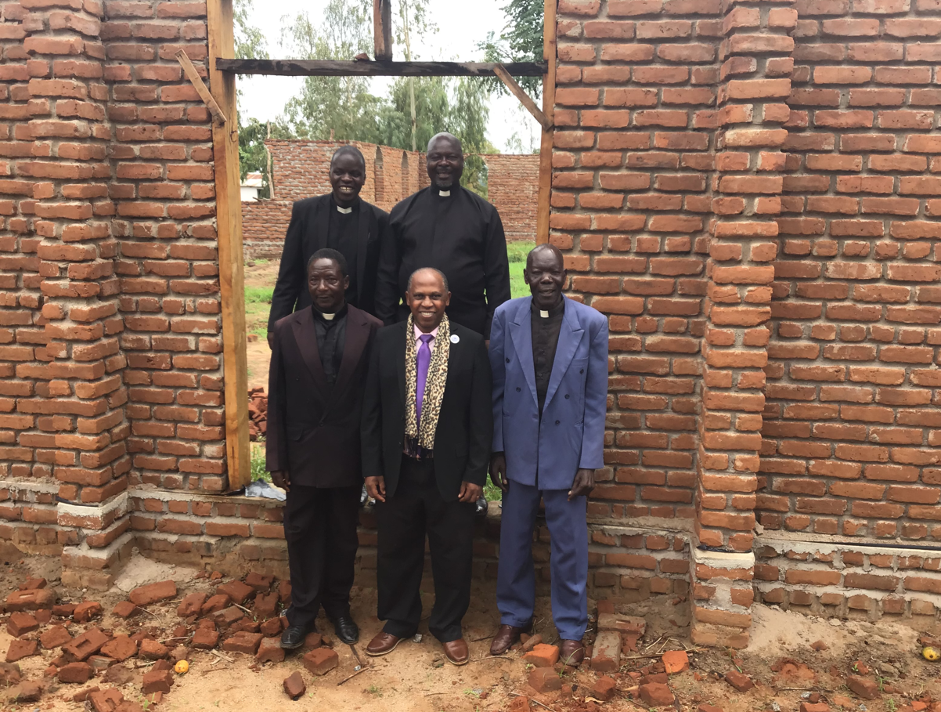
ACCOMPLISHMENTS
Construction Projects of Churches in Malawi in sympathy with Church Growth

Slide 6
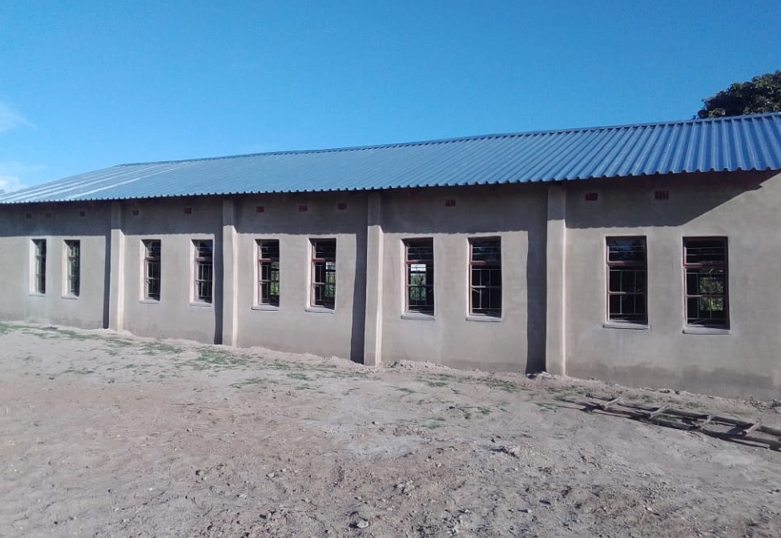
ACCOMPLISHMENTS
Construction of the Bota AME Church in Masvingo PE District, Central Zim Annual Conference

Slide 7
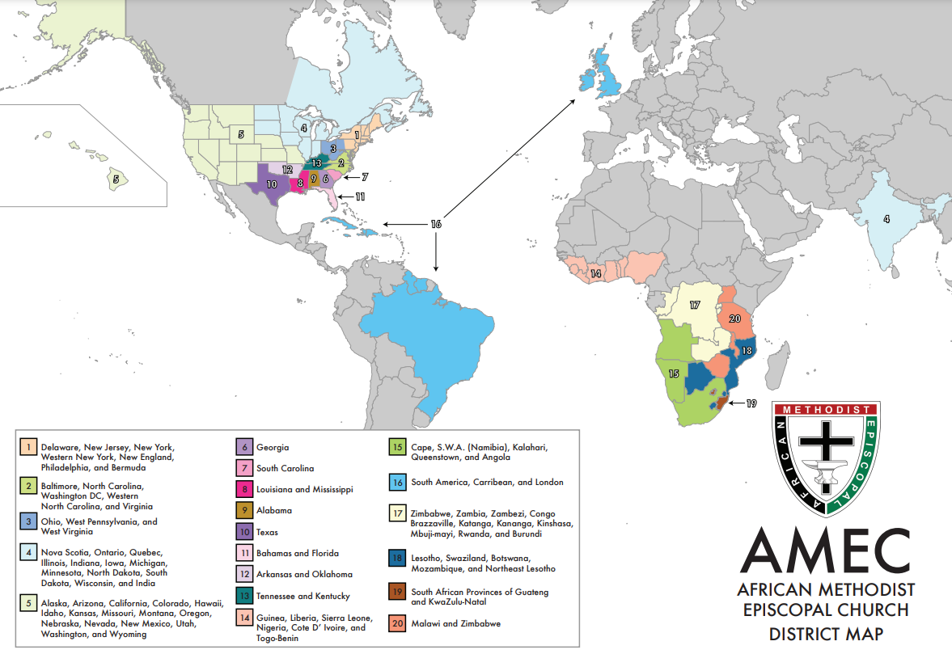
CHALLENGES
20 Episcopal District consists of 5 sovereign nations;
Zimbabwe
Malawi
Mozambique
Tanzania
Uganda
Each nation has different currencies, language, visa requirements.
Internet connectivity as well as general communication channels of road, rail and air are limited

Slide 8
CHALLENGES – HOW CAN WE HELP
Partnering with overseas districts for empowerment, rapid transfer of knowledge as well as sharing of cultural exchanges
As a Connectional Church, we are as strong as our weakest member.
We propose that the strong and well established districts to consider this partnership strategy.
Outright donations, though well-meant and certainly appreciated, are not recommended as they only cultivate donor-dependency to the beneficiaries which is counter productive and unsustainable.

Slide 9
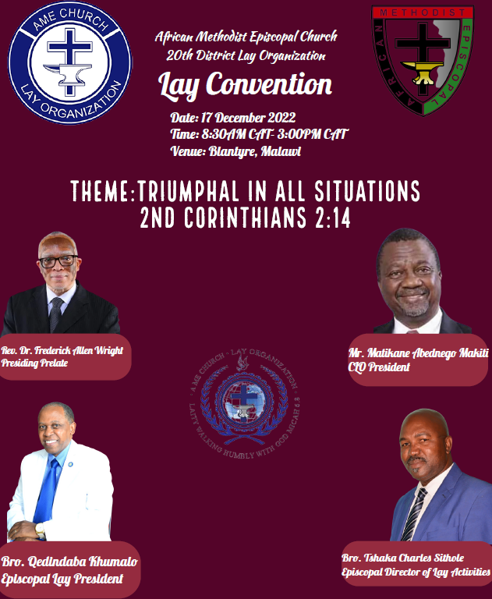
UPCOMING EVENTS
Episcopal District Lay Convention Dec 17, Blantyre, Malawi
CLO President Abe Makiti is scheduled to grace the occasion and oversee the elections for the upcoming executive.

Slide 10
Thank You - Blessings

