Slide 1
SECOND EPISCOPAL DISTRICT PRESIDENTS REPORT
MATTHEW Douglas, President
Felecia Commodore, Director of Lay Activities
Adam Johnston, Young Adult Representative

Slide 2
MEMBERSHIP
Number of active Lay Organization members in the 2nd district is 1,986; representing over 150 Lay Organizations.
Number of Young adults who are members of the Lay Organization in the 2nd district is 90.

Slide 3
TRAINING
Book Discussion with Pastor Jay Augustine Author of Called to Reconciliation (Justice, Diversity and Inclusion)
Listen, Learn Lead Empowerment Session
CLO Legislation Process Review
Cybersecurity Presentation: Hacking vs Phishing
Electoral College Presentation
Intergenerational Leadership: Passing the Baton and Bridging the Gap)

Slide 4
ACCOMPLISHMENTS
The SEDLO has been intentional with S.O.A.R.ing. Most organizations prior pandemic used the SWOT analysis to gauge where their organization stood and to point out weaknesses. By using the principles established in The Thin book SOAR by Jacqueline Stravros and Gina Hinrichs, we are being intentional with identifying Strengths, Opportunities, Aspirations and Results
I am proud of the manner in which all 5 annual conferences within the SEDLO (Baltimore, Washington, Virginia, North Carolina and Western North Carolina) have continued to operator in a hybrid manner to continue the work of the lay organization where they are planted and S.O.A.R.ing to Solve for the work ahead.

Slide 5
Opportunities
A lot of our churches are still in hybrid models of worshiping and holding meetings. So the level of consistency ebbs and flows from conference to conference and throughout the district as a whole. This is an opportunity to continually create new paradigms of ministry to be modelled and to tweak the way in which our organizations have been operating in the last few months to date.
Challenge the urge to go back to the status quo. Far too many of our churches have fallen back into the silos they were in pre pandemic and others simply chosen not to cast their net on the other side of their ministry.

Slide 6
CHALLENGES – HOW CAN WE HELP
The CLO can create more meaningful think tanks and brainstorming sessions to ensure the trainings being offered are relevant to the current conditions that many of our churches are facing and hopeful spark fresh ideas.
Hold more symposium style conversations about the current state of our Zion and the harsh realities that we are facing as a denomination. Not to bash; but to support, provide a laity prospective/ insight and help guide the overall narrative.

Slide 7
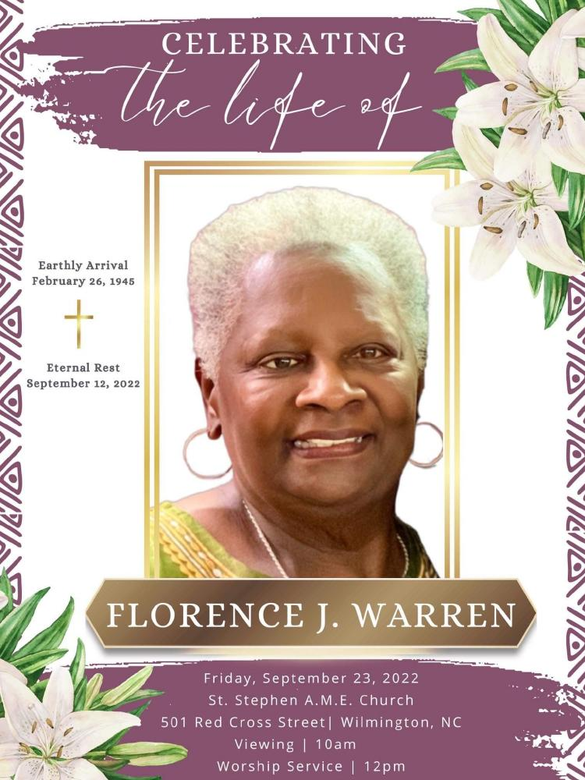
IN Memory Of:

Slide 8
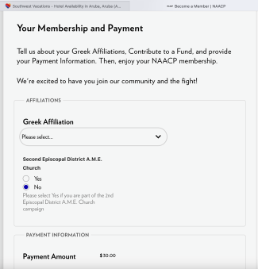
UPCOMING EVENTS

